Slide 1
Achievement First Presentation
-By Isha Jain

Slide 2
Index
Mid Year Departures
Reason behind Departures
Departures by Job Title - Resignation
Departures by Job Title - Misconduct
Status Classification – Departure Status Analysis
Voluntary Departures by Schools
Recruitment Analysis
Recruitment Status by Job Function
Diversity – Race Status by Job Function
Hired/Placed Candidates by Job Function
Hires in States by Job Function
Diversity – EEO 1st Gen by Job Function

Slide 3
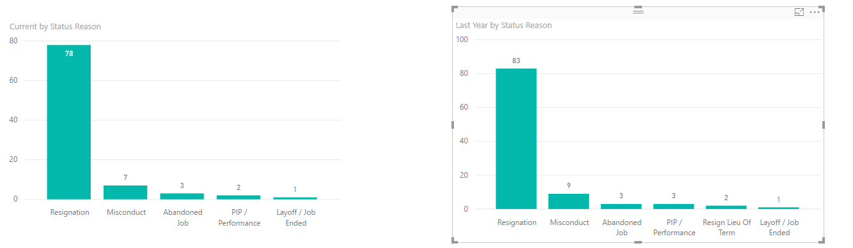
Departure Reason Analysis
Finding:
Overall the midyear departure numbers for current year are lesser than last year. However, most departures are due to resignation and misconduct.
When we look at the numbers, the numbers have improved this year, still a lot can be improved.
Recommendation:
Training can be provided to the new hires about the way they are supposed to behave within organization to reduce misconduct.
Resignation can be due to salary, long working hours, less satisfaction. This can be improved by conducting surveys & asking feedback from the current staff or people submitting resignation form.

Slide 4
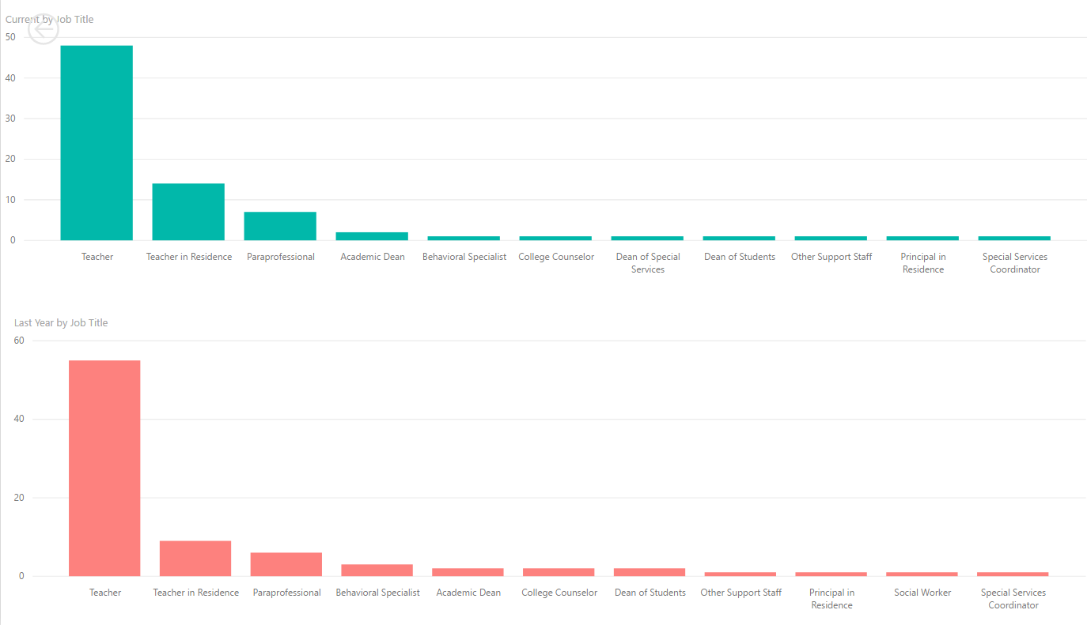
Departures by Job Title - Resignation
As we have seen resignation has been the top reason behind departures. So, on looking Resignation by Job Titles we see that More Teacher in Residence, Paraprofessional, Academic Dean have resigned this year than last year.
However, less teachers, college counsellor, dean of students have resigned in the current year than last year. Numbers for other categories haven’t improved from the last year.
Notes:
As Resignation and misconduct are the top reasons behind departures, so we will drill into both of these reasons by Job Title.

Slide 5
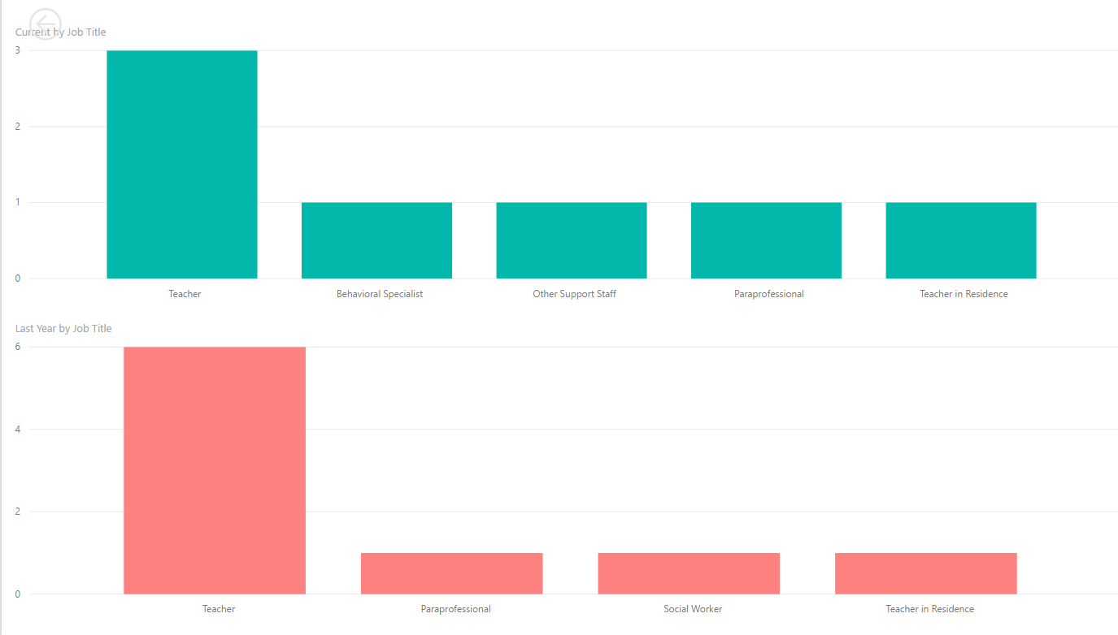
Departure by Job Title - Misconduct
Less number of teachers departed due to misconduct this year. However, Behavioral Specialist (known for managing students behavior), departed due to misconduct this year. This is an honourable post and thus, it needs to be taken care of, especially for this post.
Number of paraprofessional/Teacher in residence haven’t improved.

Slide 6
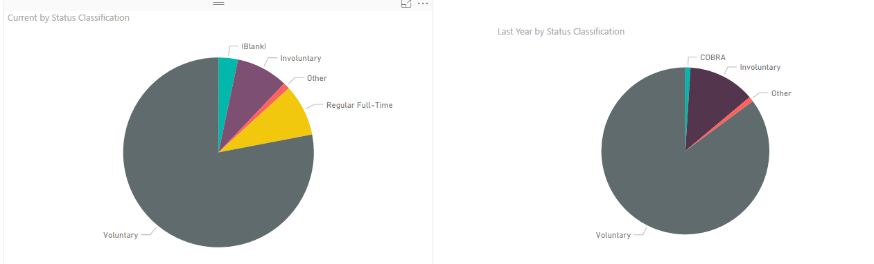
Status Classification – Departure Status Analysis
The status classification numbers for the current year are lesser than last year. But the voluntary departure status is reduced by ~15%.

Slide 7
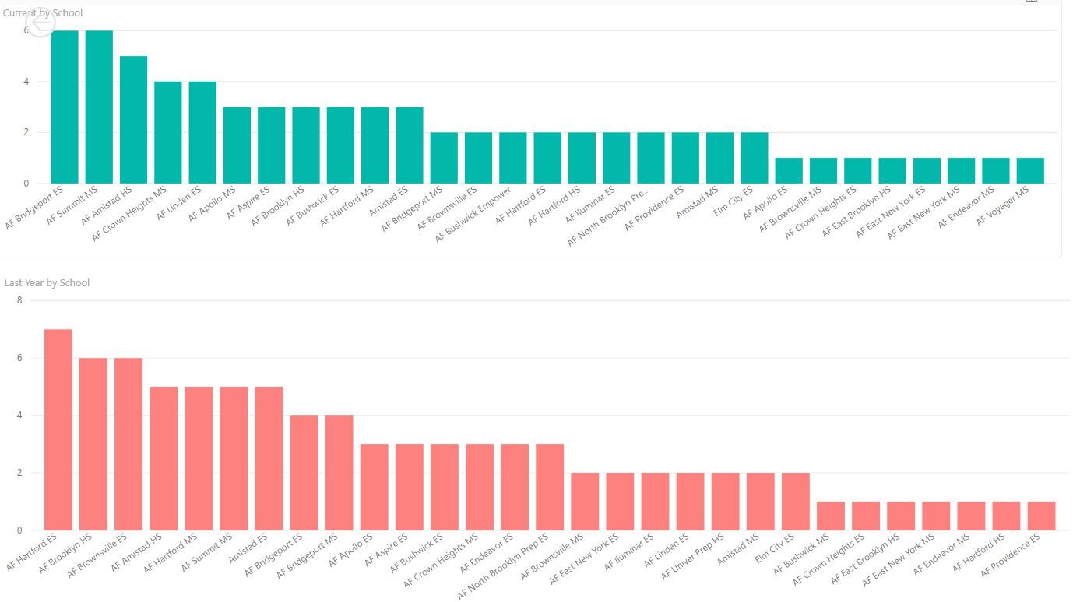
Voluntary Departures by School
Pie chart in previous slide shows that, voluntary departure numbers have reduced from the last year. However, on drilling down, we see that for some schools (~first 5 schools in current year graph) have increased from last year whereas for first five schools in last years graph has reduced .
Thus, the overall numbers have reduced but some schools have faced more voluntary departures this year than last year.
Notes:
As most departures are voluntary, so drilling down by Schools.

Slide 8
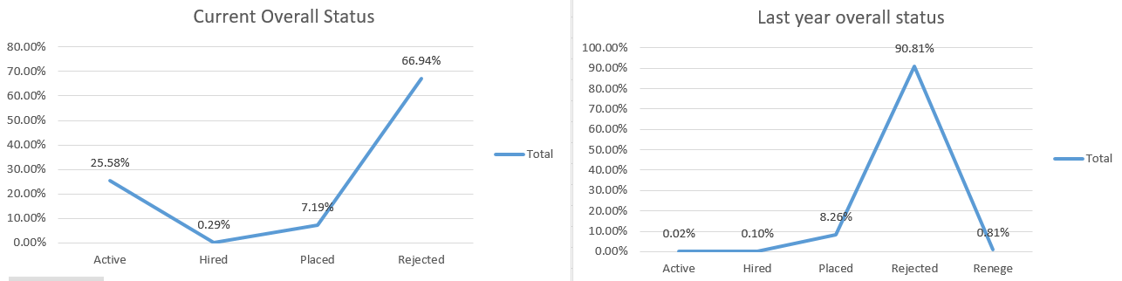
Recruitment Status by Job Function
Hiring stats have improved this year from the last year by 0.19% however, placed stats reduced by 1.07%. The number of rejected candidates have reduced a lot this year and active candidates increased by more than 25%.
Thus recruitment this year is improved a lot as compared to last year.

Slide 9
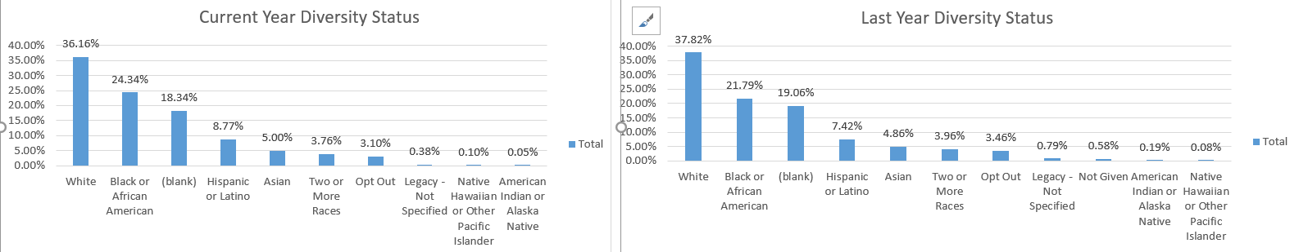
Diversity – Race Status by Job Function
Number of Whites hired reduced this year which implies that % of people from other races increased.
Blacks, Hispanics, Asians are hired more than last year. This shows that diversity has improved from the last year.

Slide 10
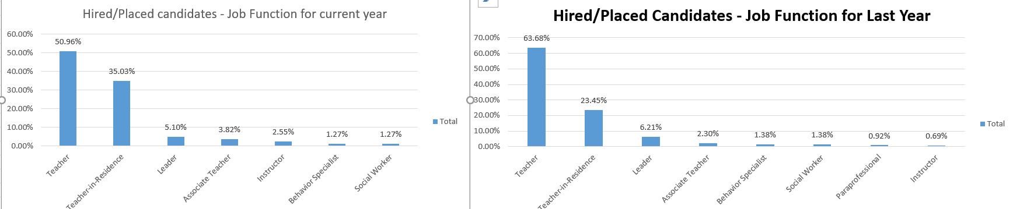
Hired/Placed Candidates by Job Function
More Teacher in Residence, Associate Teachers are hired this year. However, the number of Teachers hired has reduced by ~13%

Slide 11
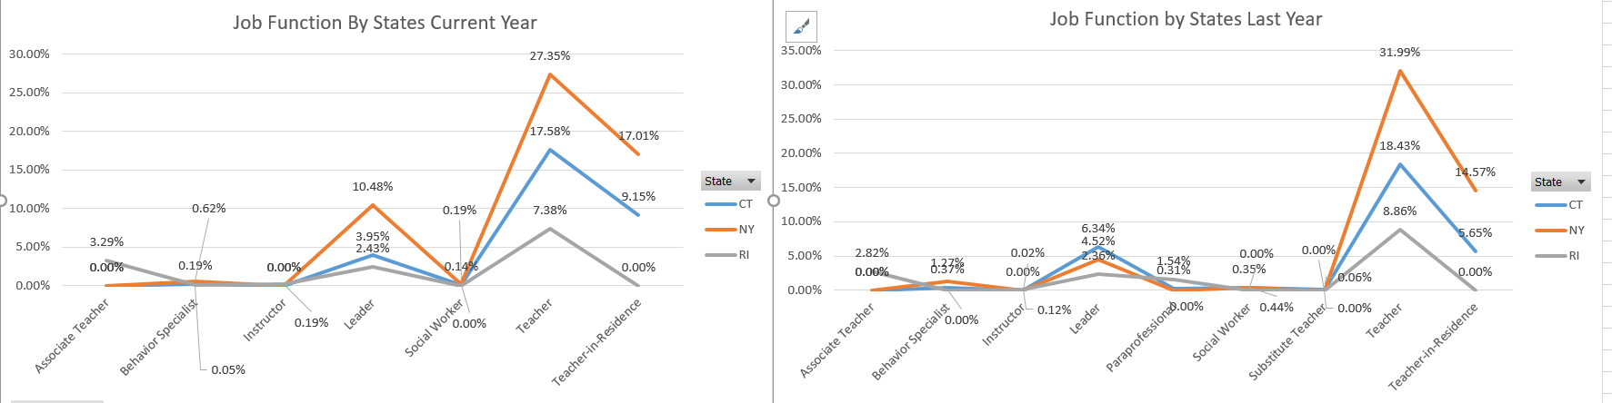
Hires in States by Job Function
RI has been on top throughout in hiring more Associate Teachers however, hasn’t hired Teacher in Residence both the years.
NY has hired most Teachers, Teacher-in-Residence(TIR) in both the years, but the stats have improved only for TIR.
CT has also hired more TIR this year than last year. CT has been on top last year in hiring most leaders however, NY topped this year for this category as well.

Slide 12
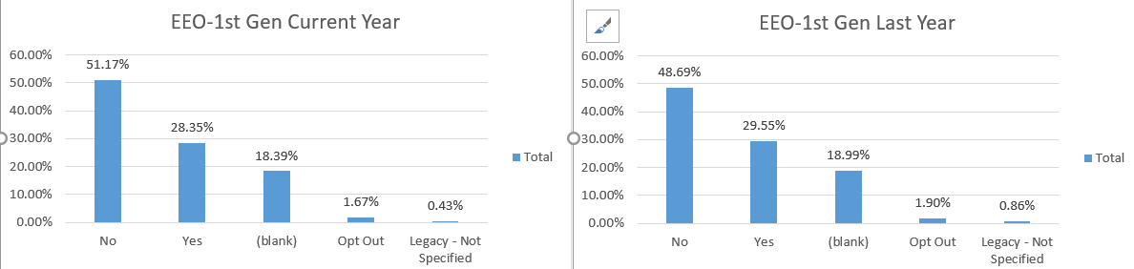
Diversity – EEO 1st Gen by Job Function
The number of hires who didn’t belong to EEO-1st Gen increased from last year.

